Slide 1

TRIBHUVAN UNIVERSITY
INSTITUTE OF ENGINEERING
Kathmandu Engineering College
Kalimati, Kathmandu
Engineering Space
Submitted By:
Anish Malla - 71007
Bhagat Gurung - 71018
Bishwas Kumar Shrestha - 71022
Om Bahadur Chhetri - 71044
Date : 2017/08/09

Slide 2

OVERVIEW
Introduction
Problem Statement
Problem
Solution
3. Objective
4. Scope and Application
5. Methodology
Model
Software Requirements Specification (SRS)
DFD Diagram
Use Case Diagram
6. Result Analysis
7. Future Enhancement
8. Conclusion
Notes:
From template
1.Introduction (it may be more than one slide)
2.Objective of your project
3.Literature Review – Problem Statement
4.Block diagram
5.Flow chart ( if necessary)
6.Methodology – Include Tools to be used
7.Application and Scope of your project ( more preferable picture representation)
8.References

Slide 3
INTRODUCTION
Engineering Space is an educational website
Provides engineering study e-materials
Provides necessary feedback to the students
YC sends notice to their student

Slide 4

PROBLEM STATEMENT
Problems
Wastage of time for searching study materials
Unaware about upcoming problems
Weak interaction between YC and students

Slide 5

Solutions
Availability of notes, slides, syllabus and old questions
Easily connected with related issues and their solutions
A bridge that makes able to interact YC and students

Slide 6
OBJECTIVES
To develop a website that provide resources for engineering students
Facilitate the communication between students and year coordinator

Slide 7
SCOPE AND APPLICATION
1111
Applicable for different colleges
Suitable to send notice by YC and exchange feedbacks by students

Slide 8

METHODOLOGY
Incremental Model
Combination of Linear sequential model and iterative approach of prototyping model
Product is developed and delivered in small increment

Slide 9
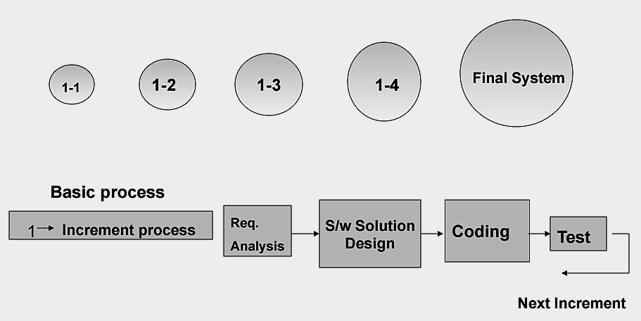
INCREMENTAL MODEL

Slide 10
Why Incremental Model?
Fast and low cost
Core product
Easy
Customers can respond to features of product
Also requirements are clearly known.

Slide 11
Software Requirement Specification (SRS)
Software Requirement
Administrator
User
Software Interface:
operating system: windows xp,vista,7,8.1,10
platform: Open Source
Database: MySQL
Language: JavaScript, HTML, CSS, Bootstrap, PHP
Hardware Interface:
Intel Pentium 4 or Higher processor
1.5 GHZ
512 MB of RAM or More

Slide 12
DFD DIAGRAMS
DFD LEVEL 0
Information
User
Engineering Space System
Request Data

Slide 13
DFD LEVEL 1
Feedback
Authentication
Feedback
Request
View / cancel
Login request
View syllabus
Accept /Deny
Syllabus
Engineering Space System
SyllabusDetail
User
Information
Request data
View old question
Old QuestionDetail
Notice Detail
Old Questions
Status
Notes Detail
View Notes
Notice
Notes

Slide 14
DFD LEVEL 2
Feedback database
Write feedback
Authentication database
Fetch user
Syllabus database
Retrieve feedback
Retrieve syllabus
Read user
Login request
Accept /Deny
Request data
View Notes
Retrieve Notes
Retrieve Questions
Old Question database
Notes database

Slide 15
ENTITY RELATIONSHIP DIAGRAM
yc_password
Sel_year
yc_id
Sel_dept
YC
Access
Register
yc_std
User
Std_id
Std_password
student
Receive
Notice
Std_batch
Std_dept
feedback
Has
Std_roll
Publish
Faculty
Load
Department
Notes
Has
Subject
Category
Old_questions
Slides

Slide 16
USE CASE DIAGRAM
Engineering Space System
Login
<<include>>
View Syllabus
Select Option
<<include>>
View Old Questions
View Contents
<<include>>
View Notes
Student
<<include>>
<<include>>
View Slides
Exchange feedback
View Notifications
<<include>>
YC
<<include>>
Give feedback
Receive Feedback
Senior
Update contents
Junior
Send Notice
Log Out

Slide 17
CLASS DIAGRAM

Slide 18

RESULT ANALYSIS
It provides engineering resources
User can view feedback about subject matters of any semester
YC can send notice to students and even update notes, slides and old questions

Slide 19

FUTURE ENHANCEMENT
To overcome the limitation as much as possible.
Enhancing the initial prototype and make user friendly interfaces.
Add more features to satisfy the Engineering Student.
Divide admin panel into teacher and administration who will manage it.
Make more protected and more secured from spam and unwanted data hazard.

Slide 20
CONCLUSION

Slide 21
APPENDIX

Slide 22
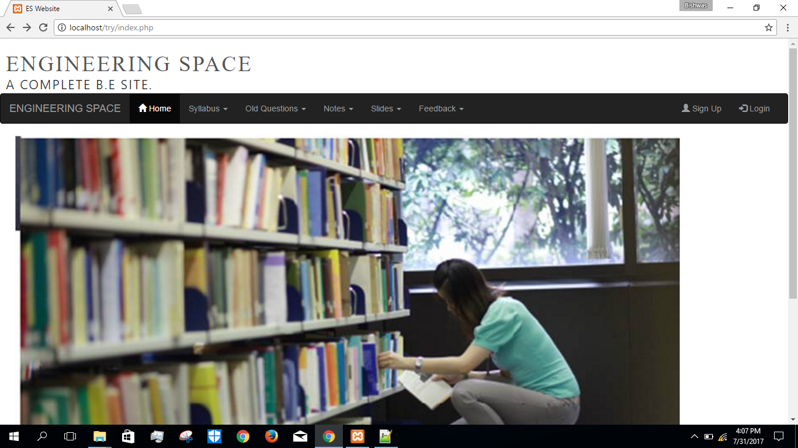

Slide 23
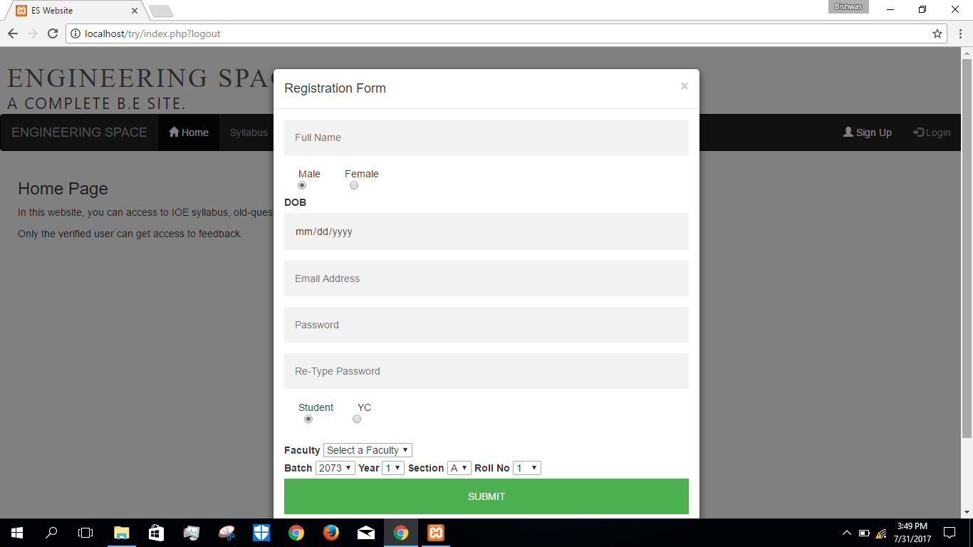

Slide 24
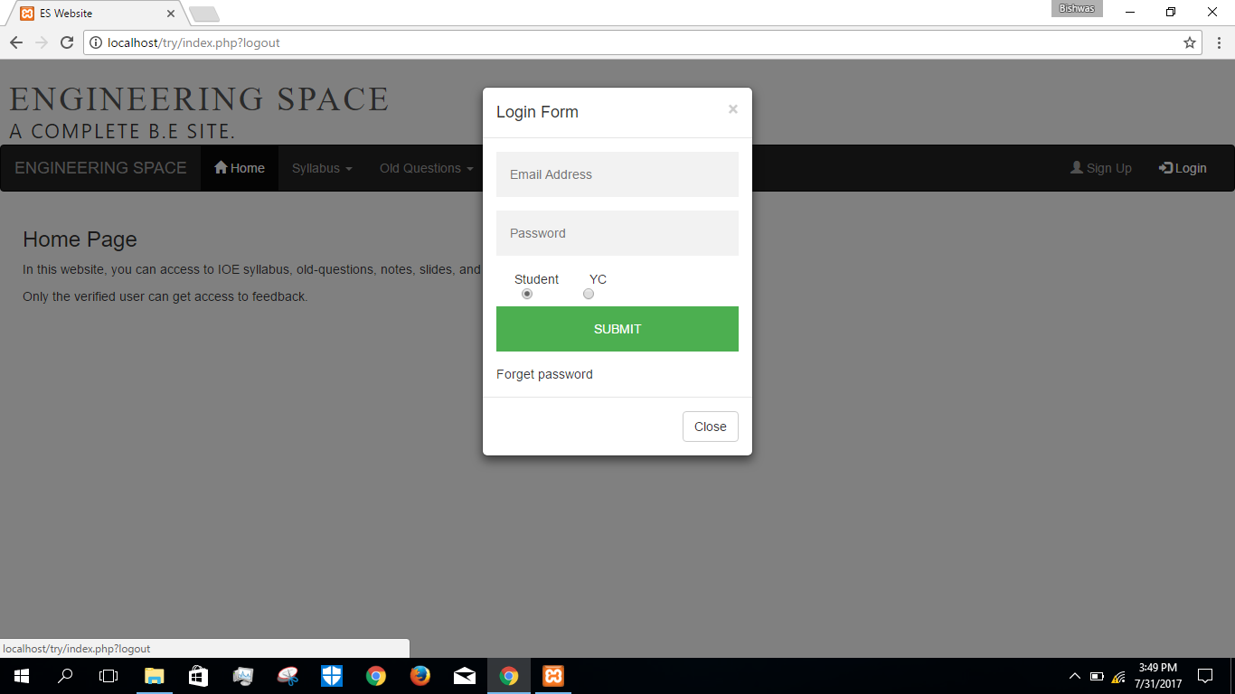

Slide 25
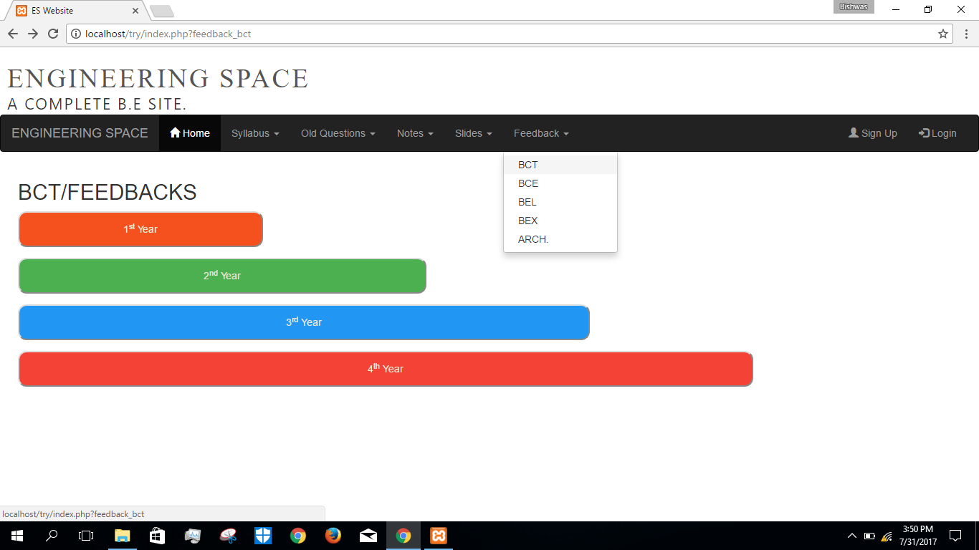

Slide 26
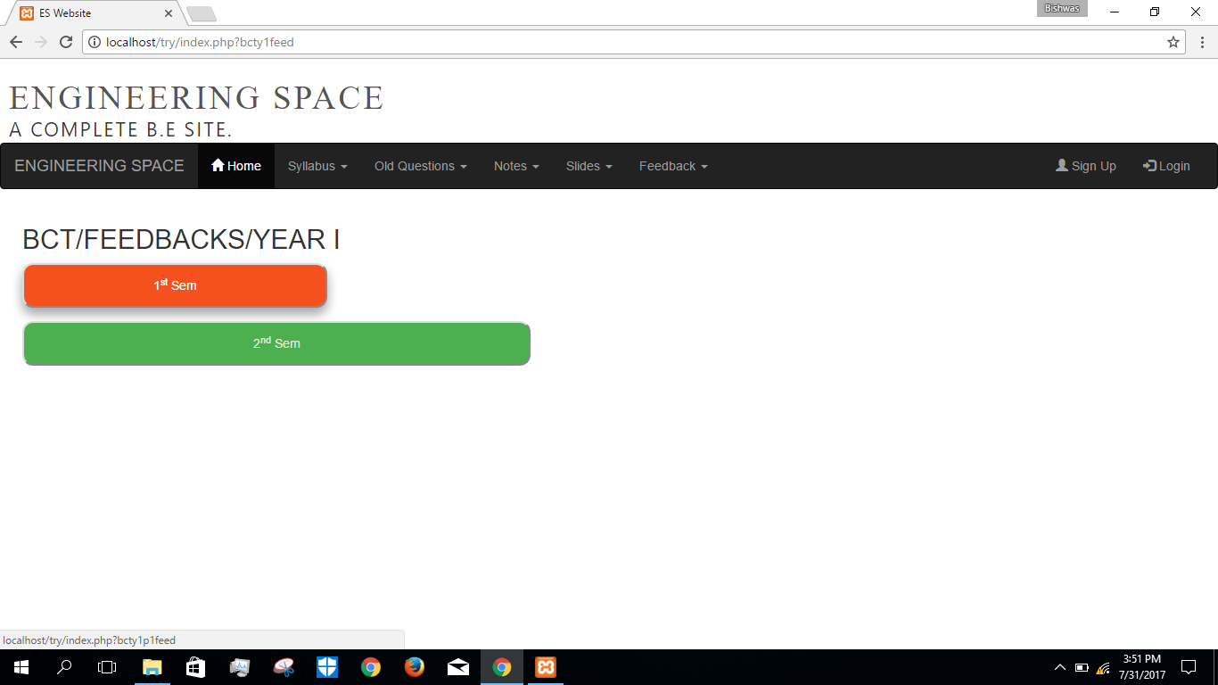

Slide 27
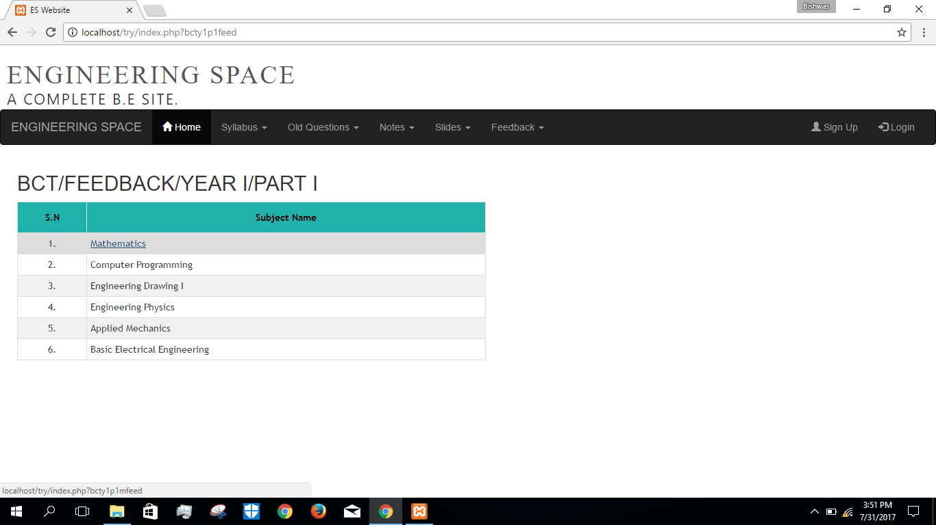

Slide 28
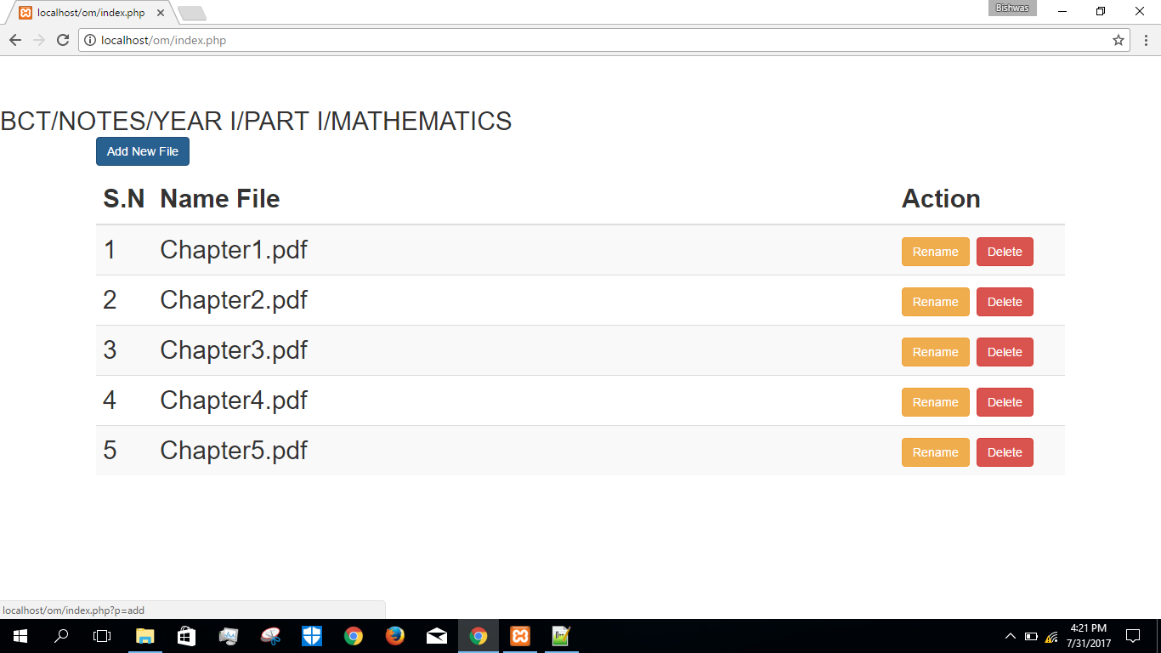

Slide 29
Thank You!

